Slide 1
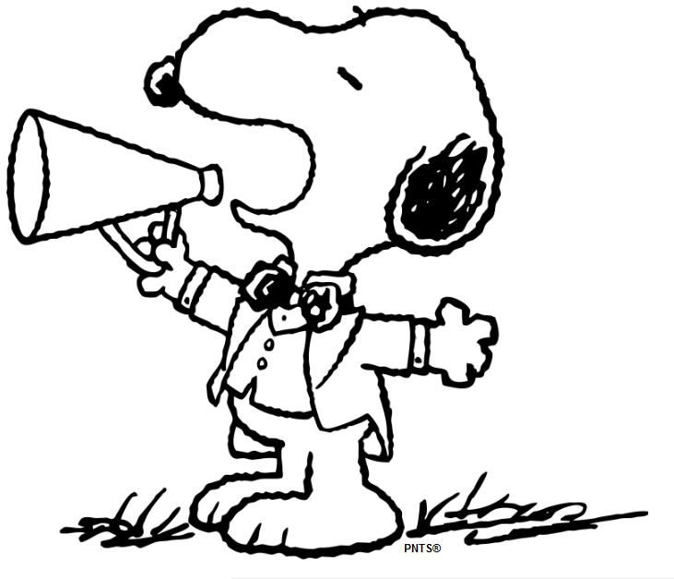
Mrs. Peacock’s Newsletter
Jan. 29- Feb. 2, 2024
Mrs. King’s
January 28-February 2, 2024
Weekly Skills
Coming up @ NSE
ELA: Compare & Contrast 2 stories
PHONICS: ARE, ERE, AIR, EAR
MATH: Adding two 3- digit numbers
LANGUAGE: Adverbs
Science: Matter- Solid, liquid, gas, volume
2/8- Progress Reports
VOCABULARY
**vocab test will be 2/9**
1.) Caption- it describes what is happening in the picture
2.) Image- a picture
3.) Similar- almost the same as something else
4.) Main Idea- what the passage is mostly about
5.) Glossary- it provides the meaning of key words
Phonics Skill OF THE WEEK
Spelling Words – ARE, ERE, AIR, EAR
wear
scare
flare
dare
glare
fair
bare
care
where
square
hare
pair
rare
hair
answer
little
stare
there
pull
full
YEARBOOKS ARE ON SALE
THROUGH FEB. 29TH!
Reminders-
Please send a water bottle & snack daily!
Homework/Tests-
Reading, Math, and facts each night.
Tests- Spelling and facts on Friday

